Slide 1

RESEARCH ETHICS: COMMITTEE for the PROTECTION of HUMAN SUBJECTS (CPHS)
Rachel Bibeault
Committee for the Protection of Human Subjects (CPHS)
Dartmouth College
© Trustees of Dartmouth College
Use only with the permission of the CPHS Office.
Notes:
The Committee for the Protection of Human Subjects (CPHS) is the Institutional Review Board (IRB) at Dartmouth College –
An IRB is a federally mandated committee with the charge of overseeing institutional research projects involving human participants.

Slide 2
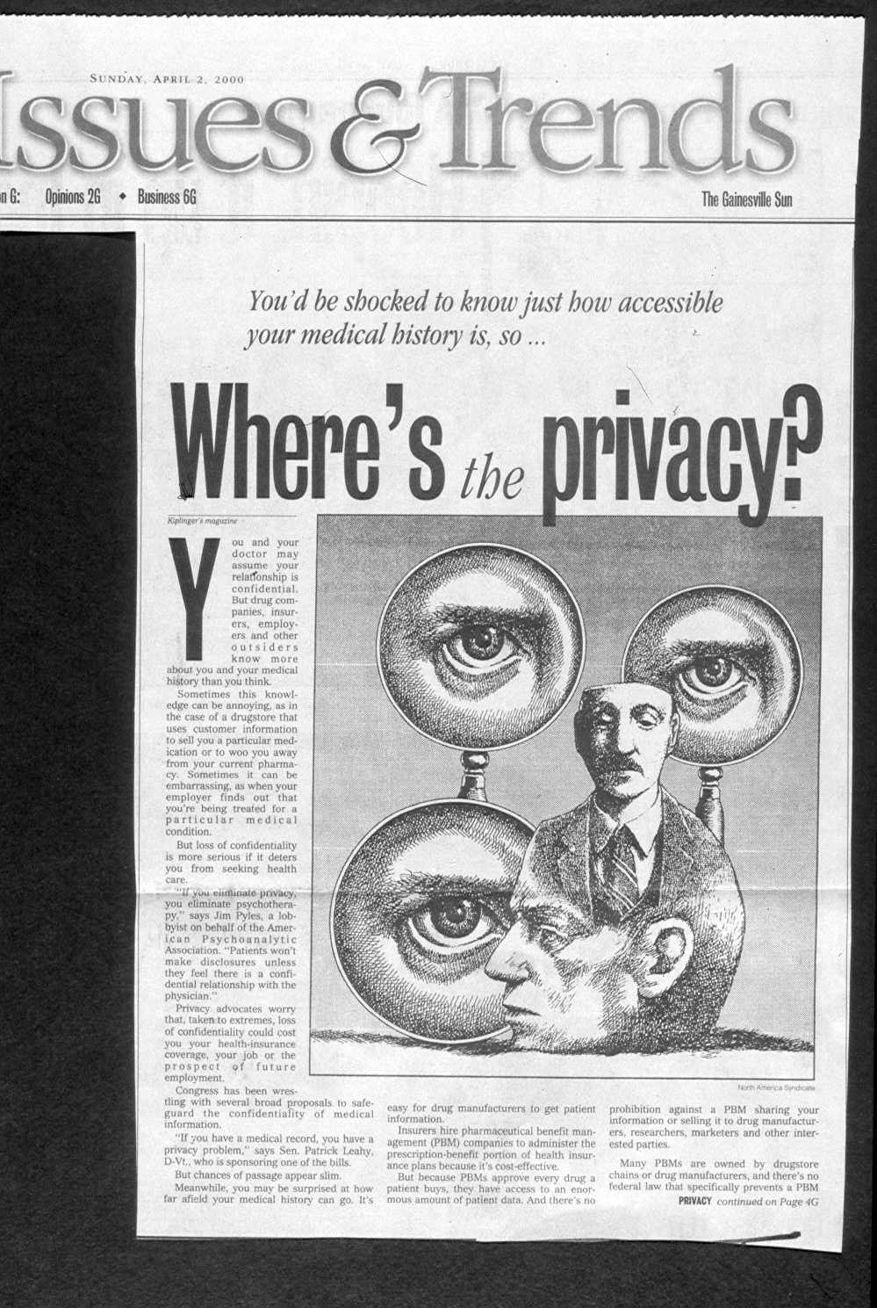

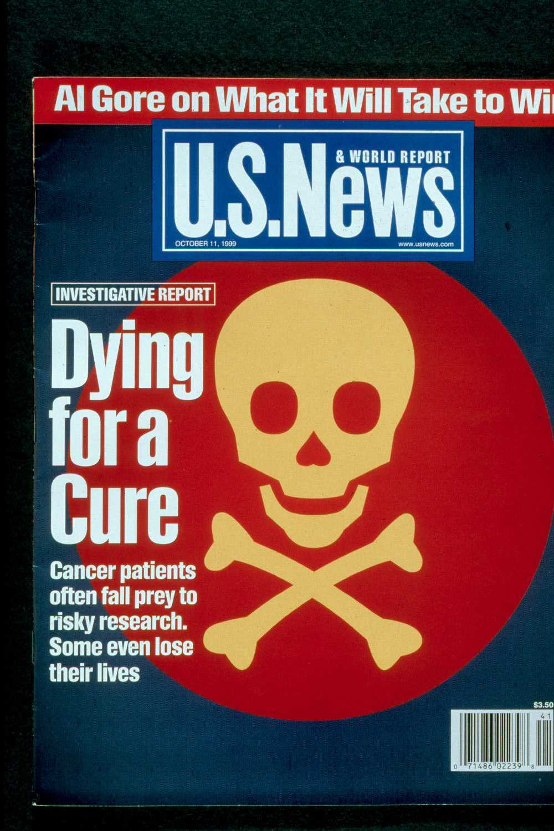



Notes:
Ethics What do we mean by ethics?
standards of right and wrong
what humans ought to do, usually in terms of rights, obligations, benefits to society, fairness, or specific virtues.
For example, reasonable obligations to refrain from rape, stealing, murder, assault, slander, and fraud.
also virtues of honesty, compassion, and loyalty.
relate to rights, such as the right to life, the right to freedom from injury, and the right to privacy.

Slide 3

History of ethical abuses and formulation of general ethical principles for research activities
Transformation of ethical principles into U.S. law and international law
Process of ethical review at Dartmouth College
Notes:
Here is an OVERVIEW of this class, we will be looking at
A BRIEF History of ethical abuses and formulation of general ethical principles for research activities. I realize you have all completed the CITI course, so I will be brief in this section.
Read the rest of the slide

Slide 4
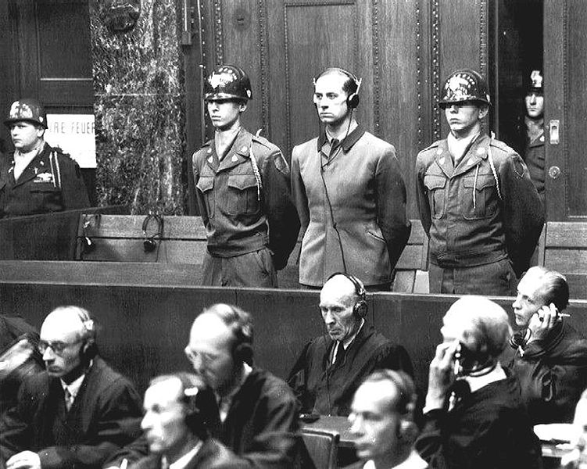
NUREMBERG Doctors TRIALS, December 1946
“The defendants in this case are charged with murder, tortures and other
atrocities committed in the name of medical science.”
Brigadier General Telford Taylor: U.S. v. Karl Brandt, et al.
Notes:
Unethical research practices first came to widespread public attention in the context of Nazi experimentation during WW II.
The “Doctors Trial” occurred in 1946, and involved the prosecution of 23 Doctors for crimes against humanity in the name of the advancement of science.
Medical experiments were performed without consent.
Those prosecuted in general used the defense that they were only following orders.
A prosecutor’s summary document has come to be known as the Nuremberg Code and is a groundbreaking expression of the ethical foundation for human research.

Slide 5
NUREMBERG CODE 1947
Voluntary informed consent absolutely essential
Research should yield useful results
Base research on prior work
Avoid physical and mental suffering
No expectation of death or disabling injury
Risk must be outweighed by importance
Subjects must be protected from injury
Qualified scientists, adequate facilities
Subject free to stop at any time
Investigator must be ready to withdraw subject.
Notes:
These are the main points of the Nuremberg code.
Research should be voluntary,
yield useful results,
avoid suffering or harm,
balance risk to benefit,
be undertaken by qualified scientists,
and participants should be able to stop at any point.

Slide 6
Staged Experiments on Obedience to Authority Stanley Milgram, Yale University, 1960’s
Fake“Student”
Researcher
Subject - “Teacher”
Notes:
In 1963, a US researcher undertook an experiment in response to concerns that the historic Nazi abuses could occur in the US.
The researcher Milgram designed a study to test obedience to authority in contradiction to ethical and moral norms.
What happened in this experiment?
Subjects were told to inflict harm ( in this case, electrocution/shock) to another person if they answered a question incorrectly
The study involved Deception: the subject was not aware that electrocution/shock was fake
ultimately the study inflicted psychological and emotional harm to the subjects
When questioned after, most subjects stated ‘they were just following orders

Slide 7
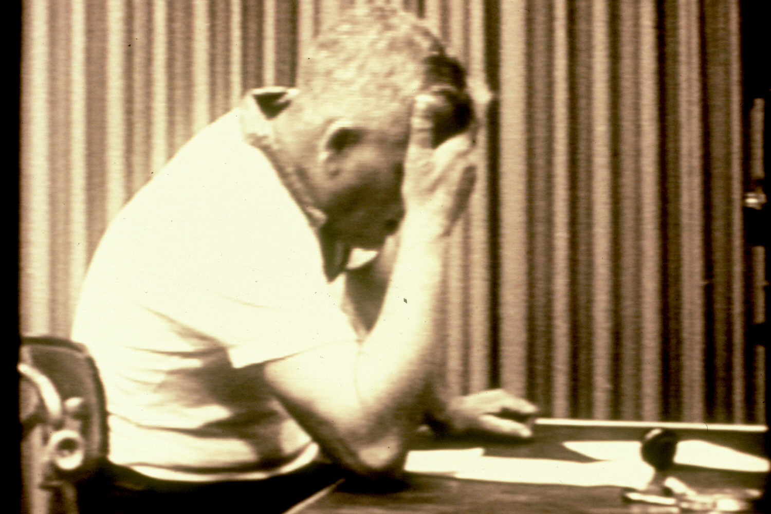
Milgram Study
“I observed a mature and initially poised businessman enter the laboratory smiling and confident. Within twenty minutes he was reduced to a twitching, stuttering wreck,who was rapidly approaching a point of nervous collapse... And yet he continued to respond to every word of the experimenter, and obeyed to the end.”
- Stanley Milgram, 1963
Notes:
One of the Major Impacts of this study was understanding that deception does not allow true consent …
And debriefing may not mitigate harms
Milgram said, “I observed a mature and initially poised businessman enter the laboratory smiling and confident. Within twenty minutes he was reduced to a twitching, stuttering wreck, who was rapidly approaching a point of nervous collapse... And yet he continued to respond to every word of the experimenter, and obeyed to the end.”

Slide 8

Tearoom Trade Study
-Deception; invasion of privacy
-Vulnerable population because of context
Notes:
The tearoom trade study was run by a sociology doctoral student, who later wrote this book.
This is another example of behavioral/social experimentation and included Several stages involving deception...
Does anyone know what happened in this study?
Observation in public restrooms
Obtaining name and address through license plates
In-home interview
Participants did not know they were research subjects.
Tried to protect identities, but considered unethical WHY?

Slide 9

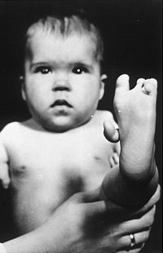
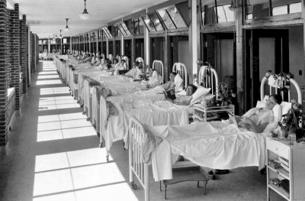
1950s | Willowbrook hepatitis studies | Deliberate exposure; children
1950s | Jewish Chronic Disease Hospital | Deliberate exposure to cancer cells; debilitated elderly
1950s | Safety of Thalidomide | Teratogenic effects
Notes:
Studies in following tables were all performed in the U.S. and involved both patients and healthy volunteers; biomedical, social and behavioral research; and involve realized harms to the safety, psychological and emotional well-being, and the economic and social interests of the participants
Willowbrook State School for Mentally Deficient Children opened in 1948.
Over 200 applications for placement that year, with an estimated “800 mentally defective children under the age of 5 who should be institutionalized”
Beginning in1956 (for 14 years) Willowbrook Hepatitis Experiments: Institutionalized mentally retarded children were intentionally infected and exposed to hepatitis so that the disease could be studied.
Please note that these studies frequently involved institutionalized populations who lacked the intimate support of family and friends
Dr. Frances Kelsey delayed FDA approval of thalidomide for use in the US, although more than 2.5 million tablets- “samples” – were distributed for investigational use. More than 10,000 children in 46 countries were estimated to have been born with deformities as a consequence of thalidomide use.
The Kefauver-Harris (Drug Efficacy) Amendments to FD&C Act resulted in 1962; required 1) informed consent of individuals who receive investigational drugs, 2) manufacturers to provide proof of safety and efficacy, 3) adverse drug reactions be reported to the FDA

Slide 10
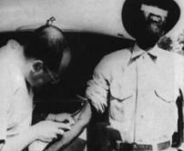
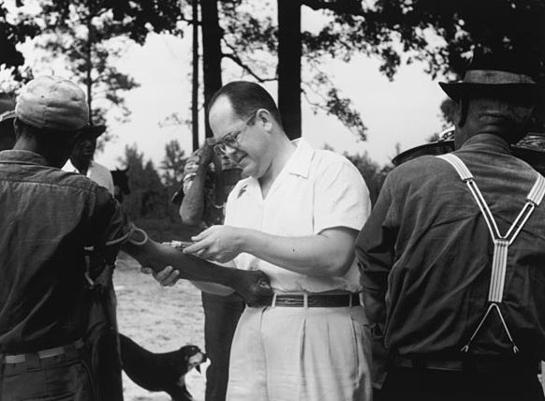
1932-1972 | Tuskegee syphilis study | Deception; deliberate failure to treat; spinal taps; indigent, poorly educated, minority, rural population
Tuskegee Syphilis Study 1932-1972
Syphilis Inoculation Study
Guatemala
1946-1948
1974: Congress passes National Research Act
1974: Congress passes
National Research Act
Notes:
The Tuskegee study involved deception of subjects and deliberate withholding of effective treatment. Study procedures were sometimes invasive, such as spinal taps, and involved physical risks.
The choice of an economically and educationally disadvantaged population for this study again created questions about the ethical norms of the research community.

Slide 11
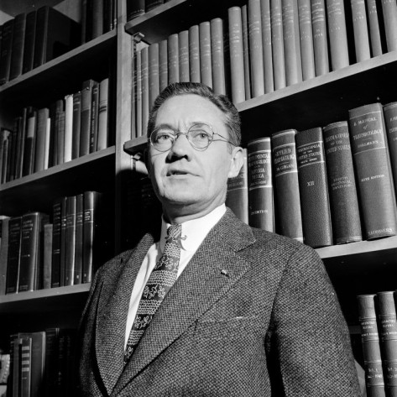
Growing Concerns…
Special Article: Ethics and Clinical Research
Henry K. Beecher, M.D.
NEJM, 274(24):367-372, June 16, 1966
“…troubling practices”
“…experimentation on a patient not for his benefit, but for that, at least in theory, of patients in general”
Notes:
1966 Henry K. Beecher, professor at Harvard wrote an article for the NEJM. This was a seminal article for biomedical research, a wake-up call cited Willowbrook in an article in The New England Journal of Medicine (in materials).
Regarding Willowbrook’s study he wrote; “There is no right to risk an injury to one person for the benefit of others”.
Examples also from: leading medical schools, university, private and VA hospitals, military and government departments and institutes, industry
Spectrum of institutional involvement suggest cultural blindness operating; this consideration is important to the evaluation of the less than adequate response in the biomedical community prompted by Beecher’s analysis
Separated the roles of physician and investigator and identified the different relationship of each to patients or subjects

Slide 12
Charge to the National Commission
Identify the basic ethical principles which should underlie the conduct of biomedical and behavioral research involving human subjects
Develop guidelines to assure that such research is conducted in accordance with those principles
National Research Act, 1974 (PL 93-348)
Notes:
The charge to the national commission was to Identify ethical principles and to Develop guidelines

Slide 13
National Research Act
1974
Department of Health, Education, and Welfare
National Commission for the Protection of Human Subjects of Biomedical and Behavioral Research, 1975-1978
125 recommendations in 17 different reports for the conduct of research involving humans
Notes:
National Research Act of 1974: was a call for regulations
The Most influential recommendations were contained in the Belmont Report

Slide 14
The Belmont Report
Respect for Persons - informed consent: information, comprehension, voluntariness
Beneficence - assessment of risks and benefits:
identify both nature and scope systematic evaluation
Justice - selection of subjects: vulnerable populations
Notes:
Application of those principles are laid out as the expectations/actions required by the human subjects protection regulations
Informed consent and the systematic evaluation of risks and benefits are idealized goals and realization remains difficult for both investigators and reviewers.
Justice in the selection of subjects has been realized in concert with awareness resulting from the civil rights and women’s movements.
Vulnerable populations include institutionalized populations, plus those who experience diminished autonomy, i.e., reduced capacity for self-protection for any reason, such as children and people with mental disabilities
A significant change in social attitudes towards research participation resulted from the AIDS epidemic: the shift from being a “guinea pig” to bringing lawsuits for access to investigational drugs, most recently by the Abigail Alliance.
International research introduces complexity in applying these ethical principles in varying social and cultural settings.

Slide 15
1972 | U.S. Department of Health, Education, and Welfare guidelines for its programs
1974 | U.S. Department of Health, Education, and Welfare regulations, 45 Code of Federal Regulations, Part 46, Subpart A
1975 | U.S. Department of Health and Human Services (DHHS) regulations, 45 Code of Federal Regulations, Part 46, Subparts B,C,D (revised in 1981 in concert with FDA regulations)
1985 | Public Law 99-158 establishes institutional review to protect the rights of human subjects in federally funded biomedical and behavioral research
1991 | Common Rule: 17 Federal agencies adopt same regulations for their programs FDA food and drug regulations
2018 | 2018 Requirements, “The New Rule” Revised January 19, 2017 and amended on January 22, 2108 and June 19, 2018.
Notes:
In the National Research Act of 1974, Congress delegated authority to Department of Health, Education, and Welfare to produce regulations, which have the force of law.
The Common Rule is also known as the “federal policy” on human subjects protection.
The rule was just updated and the changes were implemented in 2018.

Slide 16
International Ethics Oversite
 | established
Nuremberg Code | 1948
Declaration of Helsinki. | 1964
International Conference on Harmonization (ICH) | 1990
Ethical Guidelines from Council for International Organizations of Medical Sciences (CIOMS) in collaboration with the World Health Organization (WHO) | 2002
European Union General Data Protection Regulation (GDPR) | 2018
Most Countries have their own
Ethics Committees and Guidelines
Notes:
Similar timelines for regulatory evolution apply to international sites.
Most Countries have their own
Ethics Committees and Guidelines

Slide 17

Human Subjects Protection Regulations & Other
Informed consent of subjects
Ethical review of research by Institutional Review Boards (IRBs)
Institutional assurance of compliance
Code of Ethics- associations & organizations
GINA (Genetic Information Nondiscrimination Act)
State Laws (NH protection mentally ill)
International Protection-GDPR
Notes:
American Sociological Association
Human Subjects Regulations
FDA Regulations
Pertain to investigational drugs and devices
Other FDA regulated products (cosmetics, etc.)
Protections in state law also apply to the extent they exist. In general, states have enacted specific legal protections for mentally disabled populations.
GINA, the Genetic Information Non-discrimination Act, is recent legislation providing federal protections from discrimination of employers and health care insurers on the basis of genotype has reduced concern to some extent. Federal law also protects personal financial information and educational records. Research using such records should satisfy the requirements of these laws.
Protections also exist internationally-GDPR-The General Data Protection Regulation implemented 2018

Slide 18
Risk vs. Benefit
Individual
Group
Society
Privacy- control over the extent, circumstances of sharing oneself with others (behavior, intellect, physical self)
Confidentiality- treatment of information disclosed in a relationship of trust.
Deception?
Notes:
What we look at when determining if the benefit outweighs the risk

Slide 19
Risks to research participants that may produce ethical concerns
Physical
Psychological/ Emotional or “interaction risks”
discomfort or embarrassment (sensitive topic?)
Unexpected insight into one’s flaws
Social or “informational risks”
stigma
embarrassment
social standing
other effects on personal life and relationships
Financial or economic risks
employment or insurance eligibility
legal
Risks specific to vulnerable populations
Notes:
Social risks include stigma and adverse effects on reputation
“No risk” determinations by investigators frequently fail to consider full range of possible risks
Minimal risk means that the probability and magnitude of harm or discomfort anticipated in the research are not greater in and of themselves than those ordinarily encountered in daily life or during the performance of routine physical or psychological examinations or tests. Generally, the definition of minimal risk is understood to refer to healthy individuals, not the class of individuals who may have a certain disease or condition.
Vulnerable populations include institutionalized populations, economically or educationally disadvantaged populations, populations of convenience rather than having relevance to the scientific question or design or chosen as a result of a burden and benefit analysis, and groups with diminished capacity for decision-making for any reason.
International setting, different cultures- requires knowledge of social, political, cultural norms and setting. Consultant specialist, or REB in that location may be needed.

Slide 20

Protections (minimize risk)
Interaction:
Notice of information topic in advance
-Participants can self-select
Recruitment/exclusion
Design for sensitivity in discussion, ability to end conversation
Information:
Pseudonyms or codes,
data protections (paper and electronic, short and long-term)
controlled access
individual identifying characteristics
Certificate of Confidentiality
Notes:
Investigators frequently say in their materials that their project involves “No risk”
In glossing over risks, the researchers fail to consider full strategies for minimizing risk.
Social risks like stigma and adverse effects on reputation can be minimized by providing appropriate information about the research in advance so the participant may self select.
Also designing the interaction to include checking in with the participant and giving the opportunity to stop if they become uncomfortable.
Information risks may be minimized by protecting the data to the greatest practical degree.
Use multi level protections. Do not keep identifiers any longer than needed.
The NIH offers CoC s to be used when the research participation may expose illegal activities, and may provide extra protections.

Slide 21

CPHS Committee for the Protection of Human Subjects
Dartmouth College
Relying Agreements with:
other academic institutions
Hospitals or Health Clinics
Start up companies

Slide 22
Process of ethical review of student research at Dartmouth College:
Undergraduate ‘research’ / ‘project’
Classroom Coursework or Assignments | Independent student projects, theses, etc.
Receive review via your Professor or instructor | Receive review from your faculty advisor, and Committee for the Protection of Human Subjects (CPHS)
Notes:
In terms of student research
Classroom activities in research methods courses provide learning about research design, ethics, and methodology and are usually reviewed by the Professor, not the CPHS.
Independent projects and thesis projects: have an intent to create generalizable knowledge, so along with a Faculty Advisor, the CPHS does often review. The projects may also be reviewed by others- including academic dept. or oversight committees like MEIRC for studies of medical students

Slide 23

What does the process look like when a project needs review?
Notes:
So, what does the process look like?

Slide 24
Research? Regulatory definition
Research means a systematic investigation, including research development, testing and evaluation, designed to develop or contribute to generalizable knowledge.
Notes:
Is this project research?
The regulatory definition of research is
a systematic investigation,
including research development, testing and evaluation, designed to develop or contribute
to generalizable knowledge.

Slide 25
Research? yes
Human subject involved?
Human subject means a living individual about whom an investigator (whether professional or student) conducting research obtains:
(1) Data through intervention or interaction with the individual, or (2) Identifiable private information.
Not Human Subject?
-Study involved de-identified data
-Study involves data from people no longer living
Notes:
If it is research, next we consider whether or not human subjects are involved.
Research obtaining
Data through intervention or interaction with people
or
“identifiable private information” or information which an individual can reasonably expect will not be made public

Slide 26
Exempt from IRB review?
Categories include:
- Research that only includes survey procedures, interview procedures, or observation of public behavior
- Research involving benign behavioral interventions in conjunction with the collection of information
- Secondary research data and information
Notes:
If human subjects are indeed involved, then we consider the level of review.
The regulations provide categories of research which are exempt from the rest of the regulations.
Federal agency guidance makes clear that IRBs are expected to make exemption determinations, not investigators
Exemption categories are available on CPHS website and on Exempt application materials

Slide 27
Research? Regulatory definition
yes
Human subject involved? Regulatory definition
yes
Exempt from IRB review? 8 categories
no
Eligible for expedited review? Minimal risk?
The probability and magnitude of harm or discomfort anticipated in the research are not greater in and of themselves than those ordinarily encountered in daily life or during the performance of routine physical or psychological examinations or tests.
Notes:
Exempt categories are fairly narrow, so if your research does not fit an Exempt category, we consider whether or not the project may have an expedited review.
Projects must present no more than minimal risk to be expedited. Expedited studies no longer require an annual continuing review since the regulations were updated in 2018.

Slide 28
EXPEDITED Categories
-Category #2: Collection of blood samples by finger stick, heel stick, ear stick, or venipuncture …
- Category #3: Prospective collection of biological specimens for research purposes by noninvasive means.
- Category #4: Collection of data through noninvasive procedures routinely employed in clinical practice…
- Category #5: Research involving materials (data, documents, records, or specimens)…
- Category #6: Collection of data from voice, video, digital, or image recordings made for research purposes
- Category #7: Research on individual or group characteristics or behavior (including, but not limited to, research on perception, cognition, motivation, identity, language, communication, cultural beliefs or practices, and social behavior) or research employing survey, interview, oral history, focus group, program evaluation, human factors evaluation, or quality assurance methodologies.
Notes:
These are some of the category definitions used most. If your project does not fit an Exempt category, and is no more than minimal risk, fill out the minimal risk study plan that fits your project best (clinical or non clinical).

Slide 29
Research? yes
Human subject involved? yes
Exempt from IRB review? no
Eligible for expedited review? No
IRB review at convened meeting
Notes:
A Quorum of members must be present at the meeting;
Approval is by majority vote
Sometimes the Committee decides minor changes are needed.
Sometimes the research project is disapproved and may not be reviewed again without major changes.
Sometimes the study is tabled if it seems acceptable but does not include enough information for the review.

Slide 30
Regulatory Criteria for Review
-Scientific design appropriate
-Minimize risks and maximize benefits to participants
-Risk-benefit assessment for participants
-Appropriate and equitable selection of participants
Notes:
Criteria for approval are many, here are some of those elements
Good Scientific design
Assessment of the Balance of risks and benefits
Appropriate Selection of participants

Slide 31
Regulatory Criteria for Review: Informed Consent
A process, not a document → Permission
-research purpose
-duration of participation
-description of procedures, risks, benefits
-alternatives to participation
-extent of confidentiality of research records
-contact information for investigator
-Assurance of a right to withdraw
-Assurance of voluntariness
-Authorization for research use and disclosure of protected health information.
Notes:
Regulations require 9 criteria must be present in the consent document.
Includes what the potential participant needs to know in order to decide whether or not to participate.
Of note, Voluntariness and the right to withdraw must be presented.

Slide 32
Regulatory Criteria for Review: Informed Consent
Alterations and waivers of consent or authorization require justifications by the investigator that satisfy specific regulatory criteria
of entire consent process and/or documentation
of signed consent document
Notes:
The regulations provide for Altered consent processes, like no signature required or a shortened summary of information used.
Or a Waiver, when no consent process or consent AT ALL is a justified option.
In both cases a robust justification must be provided. Consent is almost never completely waived if the person is in front of the researcher, either physically or virtually.
It is important in international studies to consider the acceptability of methods of consent within the culture of study population.

Slide 33

Surveys, Interview Procedures
Study design to ensure sample surveyed or interviewed is appropriate.
How will surveys be distributed and collected?
Types of questions being asked?
Sensitive questions? Potential for interviewee discomfort? Informational risks?
Are surveys anonymous?
Try to anticipate difficult situations and be prepared.
Notes:
Study design should ensure quality data in collected.
Consider Distribution, and collection of surveys
Self stamped envelopes, centrally located drop boxes, or electronic platforms
Anonymous? De-Identified?
For Example, in a too small a sample size, researchers may be able to tell who people are by the answers
Questions sensitive in nature?
Don’t ask people open ended questions that will get them in trouble
For interviews: anticipate difficult situations, what might happen
Like Suicidal ideation AND HAVE A PLAN

Slide 34

Surveys, Interview Procedures
Potential participants should be aware of:
Your name and affiliation with Dartmouth
The reason for the project
The level of confidentiality of responses
The voluntary nature of the project.
Notes:
Touching on Informed Consent for surveys and interviews OFTEN ALTERED CONSENT
Altered consent may be accomplished verbally, through an information sheet, or through a few sentences at the beginning of a survey instrument.
IMPORTANT! For Audio recording… get consent verbally on tape or you may need a signature.

Slide 35


International setting and other cultures:
Consent
Autonomy
Role of individual in society/group
Vulnerability
Laws
Notes:
International research introduces complexity
in applying the ethical principles we have just talked about.
We need to consider Consent carefully with local customs in mind. Beliefs regarding Autonomy are varied in other societies.
+Sometimes a signature would never be asked for in another culture.
+Sometimes a Chief or other leader gives consent for all.
+In some areas a single woman would not be allowed to speak with a researcher who is a man without a male relative present.
Researchers should seek to understand local context.

Slide 36

Who can help with context?
Experienced researchers, consultants, faculty advisor,
local ethics boards, universities, aid organizations
Notes:
Who can help with context?
Locally, experienced researchers, consultants, and faculty advisors, even other students who have been to the same area before.
On site, local ethics boards, universities near by, and often aid organizations are good resources.

Slide 37


International considerations
Rationale for conducting research
Local Ethics Committee
Knowledge of relevant laws, regulations, guidance and customs
Mechanisms for communicating
Risks acceptable in the social context of the host country?
If compensation is being offered is it appropriate for the setting?
Will the results of the research be used at the host site?
What about GDPR?
Notes:
When a research project will be run internationally we look at particular aspects of the project.
Is the project worth doing for the participants?
Do the researchers know about the local context?
What about language? Will there be interpreters?
Can researchers be in touch with CPHS if something arises?

Slide 38

a list of countries that have implemented the GDPR:
Austria
Belgium
Bulgaria
Croatia
Republic of Cyprus
Czech Republic
Denmark
Estonia
Finland
France
Germany
Greece
Hungary
Iceland
Ireland
Italy
Latvia
Liechtenstein
Lithuania
Luxembourg
Malta
Netherlands
Norway
Poland
Portugal
Romania
Slovakia
Slovenia
Spain
Sweden
United Kingdom
Notes:
Here is a list of countries that have implemented GDPR. Some countries include overseas regions or territories that have also adopted or plan to adopt GDPR, like Greenland, Aruba and Bermuda.

Slide 39
Points to Remember:
-Consider and prevent any exploitation or harm to interviewees /participants
-Conduct project in a professional manner.
-Be well grounded in the background of subjects
-Treat potential participants with respect
-Tell CPHS about your project BEFORE you start!
-Let us know if activities change and when study activities are complete
Notes:
Consider and prevent exploitation or harm
Be professional.
Be aware of context
Be respectful
Tell CPHS about your project BEFORE you start!
By regulation CPHS must review the research BEFORE it begins!
Let us know if activities change significantly during the study and when study activities are complete

Slide 40
What CPHS Needs for Review
Funding or other proposal document
Study Plans:
Description of the proposed research activities
Recruitment of participants (posters, ads, etc.)
Consent process and documents
Protection of privacy
Data management, including maintenance of confidentiality, security, and incidental findings
International form
Instruments
Survey questions , Interview questions
Notes:
Remember: the level of risk determines the specific application / forms. Check out the forms on out website.
We will need
The Funding proposal
Research Plans, protocol or application (choice on the website)
Describe activities, answer all questions,
Provide for recruitment, consent, protection of privacy and confidentiality information
Provide separate documentation like advertisements, and information sheets
International form needs to be filled out
Surveys, scripts, focus group guides.
Our electronic submission system is RAPPORT and there are links on our website.

Slide 41
CPHS WEBSITE
www.dartmouth.edu/~cphs
Office for Human Research Protection
US Department of Health and Human Services
http://www.hhs.gov/ohrp/
Thank You!

Slide 42
Use the link below to certify that you have fulfilled the IRB's education requirement. Use your NetId and associated password to log in. https://dartmouth.co1.qualtrics.com/jfe/form/SV_0p64SY51z0bjj13

